Slide 1
HEALHT ASSESSMENT

Slide 2
There are three groups of methods of examination:
Subjective method of examination
Objective method of examination
Additional method of examination (laboratory-instrumental)
Subjective method of examination
COLLECTION of INFORMATION (questioning)
GENERAL INSPECTION
ASSESSMENT OF THE VITAL FUNCTIONS

Slide 3
Questioning
The Questioning consists of four parts: Passport data (biographic) 2. Patient’s complaints 3. Anamnesis (history) of present illness 4. Anamnesis of life (past medical history)
Objective methods of examination (The Physical Examination)
The components of a physical examination include:
Inspection (general outer inspection)
Palpation
Percussion
Auscultation

Slide 4
GENERAL (OUTER) INSPECTION
1. General condition 2. Mental status (consciousness) 3. Position of patient on bed 4. Body shape 5. Posture, gait 6. Body temperature 7. Examination of the skin, skin appendages (nails, hair and visible mucous membranes 8. Inspection of subcutaneous fatty tissue
1. General condition Evaluating the general condition (severity status) makes after a complete examination of the patient
It is customary to distinguish between the following gradation of the General condition:
satisfactory,
moderate,
severe,
extremely severe,
terminal condition (agonal, clinical death).

Slide 5
The severity of the condition is characterized by:
1. The degree of violation of the vital functions
2.The degree of threat directly the life of the patient
3.Possibility of serious complications in the nearest future life
A satisfactory condition (Good)
A person active, freely walks, communicates with other patients Vital signs are stable and within normal limits. Patient is conscious and comfortable.
The condition of moderate severity (Fair)
Vital signs are stable and within normal limits. Patient is conscious, but may be uncomfortable. Indicators are favorable.
Severe condition. (Serious) The patient is in an untenable situation often lies in bed, consciousness may be clear, but often violated (stupor, a sopor)
Vital signs may be unstable and not within normal limits. Patient is acutely ill. There is danger to life.
Extremely severe condition (Critical)
The patient's position on bed is passive
Patient may be unconscious
Vital signs are unstable
Without emergency medical care the patient will die
Terminal condition (agonal condition, clinical death)

Slide 6
2. Mental status (Consciousness) In the evaluation of consciousness you need to determine how adequately the patient perceives the environment, responds to the medical staff that understands the questions he was asked how quickly responds
If the patient does not respond to the questions, you can use to the following methods:
Call him loudly
Shake him slightly as you wake a sleeping person
If the patient does not respond, you should determine the degree of oppression consciousness (level of consciousness)
Not disturbed consciousness is called «Сlear»
The patient is completely oriented in the environment, clearly answers the questions

Slide 7
Not disturbed consciousness is called «Сlear»
The patient is completely oriented in the environment, clearly answers the questions
Violation of consciousness can be quantitative and qualitative
Qualitative violations of consciousness (mental disorders) When Qualitative impairment of consciousness may experience delirium, hallucinations
Quantitative violations consciousness
Types of oppression consciousness with increasing of severity:
Stupor
Sopor
Coma
Stupor (stun) - a state of stunned. The patient comes in contact. But the patient is disorientated, bewilderment, and difficulty following commands, answers the questions slowly, with a short delay.
The sopor (hibernation) is a condition of abnormally deep sleep. Person can still react to stimuli but falls back in the pathological sleep.
The patient does not respond to others, although sensitivity, including painful saved. On questions does not respond or responds with one word (Yes - No), responds to the physical examination.
Coma is a state of deep oppression of the Central nervous system and disorders of the regulation of the vital functions of the organism.
The patient is unconscious. Respiratory and cardiac activity saved. There is a decrease in or disappearance of basic reflexes.

Slide 8
3. The patient’s positions on bed Types of the patient’s positions on bed
• active
• passive
• forced
The active position is the possibility of self, the active movements.
Be aware that for different age categories activity may be different.
Passive position is the absence of the patient's ability to self-service (coma, severe weakness, paralysis).
Forced position
Patient takes the forced position often unconsciously, to ease suffering.
Sometimes forced position of patient is very characteristic for some disease or syndrome.

Slide 9
Types of forced position:
1) Forced position - Orthopnea - sitting or lying in bed with a raised head end and lowered his legs.
Disease: heart failure.
A mechanism to ease the condition. The decrease of shortness of breath at the expense of Deposit of the blood in the lower limbs.

Slide 10
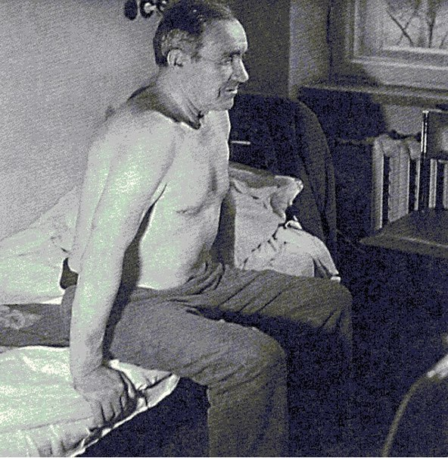
2) Forced position - Orthopnea - a sitting Position, leaning his hands on the edge of the bed Disease: bronchial asthma A mechanism to ease the condition. Mobilization of accessory respiratory muscles, which allows to make exhale active

Slide 11
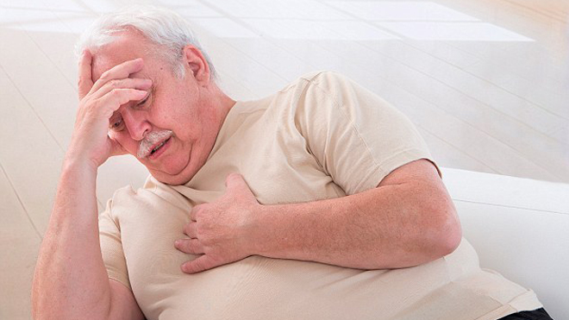
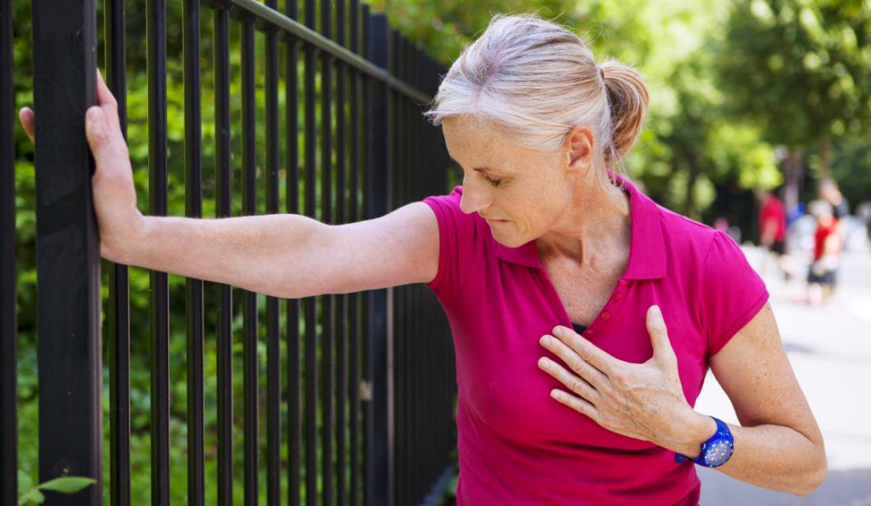
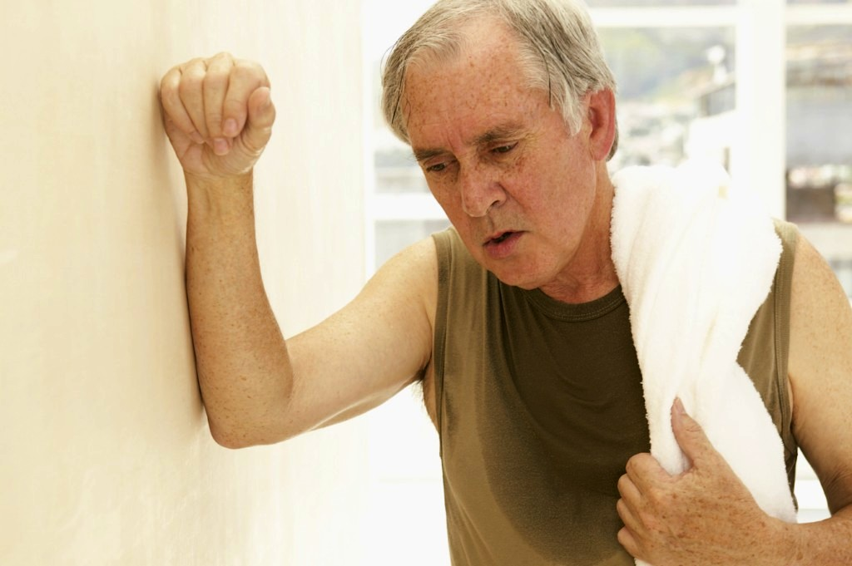
3) Forced position - the standing - symptom "shop window". Because stenokardicheskie pain in the sternum, created by walking, the patient is forced to stop.
Disease: attack of angina
A mechanism to ease the condition. Reducing consumption miocardom oxygen at the termination of movement; facilitating the work of the heart at the expense of Deposit of the blood in the lower extremities

Slide 12
4) Forced position - Pose "praying position " - the patient is sitting on the bed, bent over, resting on the pillow
Disease: Pericardial effusion
A mechanism to ease the condition. In this position, the liquid collects in the bottom part of the fibrous-serous membranes of the heart (the pericardium), and therefore less pressure on the heart and large vessels. "Floating" heart over liquid makes it work.

Slide 13
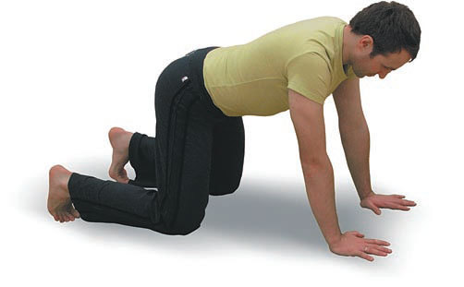
5) Forced position - Position "a la vache" (from French "cow") – is a four standing position.
Disease: tumor of pancreas, stomach or another organ of the abdominal cavity.
Mechanism of relief. In this position the tumor puts less pressure on solar plexus and pain decreases.

Slide 14
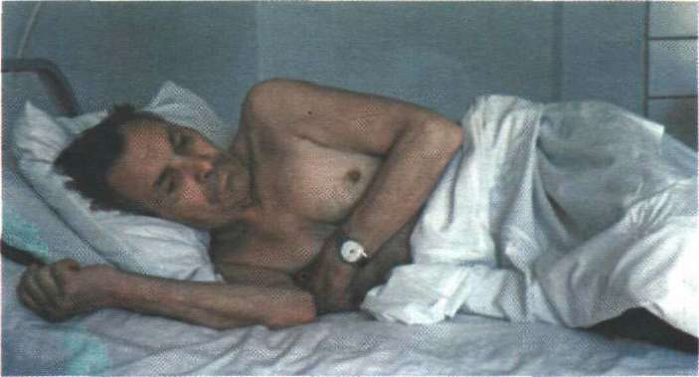
6) Forced position - Lying on a sick side Disease: Dry pleurisy, Rib fracture Mechanism of relief. Limiting of pleural layers friction of the affected side.

Slide 15
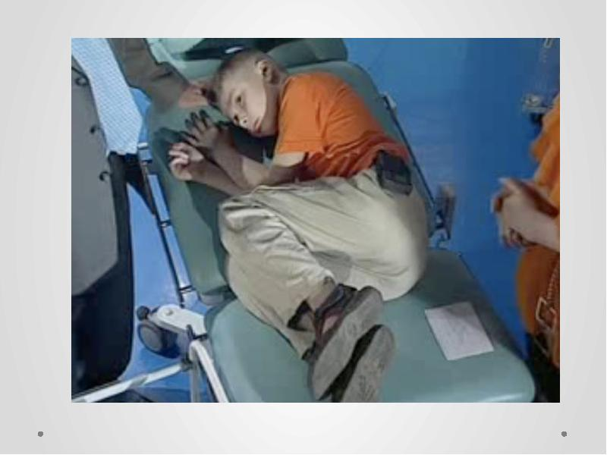
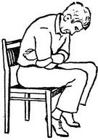
7) Forced position - to sit or lie bended with hands pressed against epigastric region
Disease: gastric Ulcer (localized on a posterior wall)
Mechanism of relief. Acidic gastric juice ebbs away from the ulcer, warm hands reduces paroxysm of unstriated muscles.

Slide 16
8) Forced position - Pointing dog position – the patient lies on the side, with legs bent and pressed against the stomach, the head is thrown back
Disease: Meningitis
Mechanism of relief. This position is caused by lower extremities muscles contracture (Kernig`s symptom) and occipitals contracture (neck stiffness)

Slide 17
4. Body build (Habitus)
The Body build is a collective term that includes constitutional type, anthropometric data (height, weight).
Body type is a set of functional and morphological characteristics of a body, based on the hereditary and acquired characteristics.
Body build:
Normosthenic
Hypersthenic
Asthenic

Slide 18
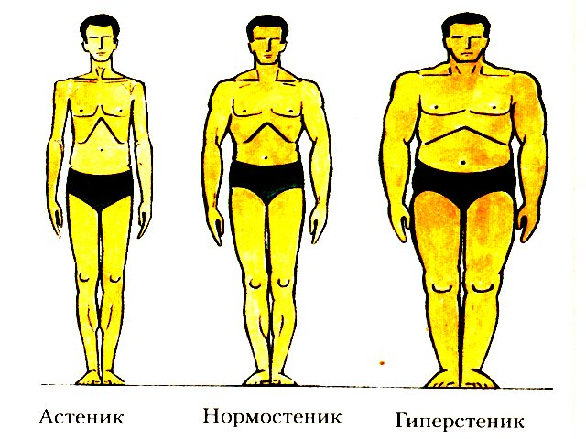
Normosthenic type is characterized by regular build and body balance, well-developed skeletal muscles, and regular form of the chest. Epigastric angle is 90 degrees.
Asthenic type – is often characterized by its length development. Muscles are weak, neck is long. Chest is narrow and contracted. Its lateral dimension is much bigger than anterioposterior dimension. Epigastric angle narrow (less than 90 degrees). Ribs are oblique, intercostal spaces are increased. The blade bones doesn`t bear against the chest.

Slide 19
Hypersthenic type is characterized by width development. Height is average, supernutrition, muscles are well-developed. Shoulders are wide and a neck is short. An abdomen is increased in volume. Chest is wide, its anterioposterior size is increased. Epigastric angle is blunt(more than 90 degrees), intercostal spaces are narrow.
Height . Normal adult height varies from 1.5 m to 2 m There are some deviations from the norm: Gigantism Dwarfism
6. Body temperature In a healthy person body temperature varies to a small degree from 36,4 C to 36,9°C
In hospital thermometry is made twice a day - in the morning in the fasted state (at 7-8 a.m. and at 5-6 p.m. before the last meal).
The temperature may be taken every 3 hours for specific indications.

Slide 20
7. Skin and visible mucous membrane, hair, and nails examination
skin color • moisture • turgor • lesions (abnormal skin elements) "skin cleanliness" • condition of nails and hair
Thermometry
Armpits • Oral cavity (the thermometer is placed under the tongue)
• Inguinal folds (in children) • Rectum (the temperature of the rectum is usually 0.5-1 degree Celsius higher than of the armpit)
In addition to thermometry, it is necessary to check the temperature of any hyperemic skin area. In case of inflammatory there is localized temperature rise.

Slide 21
Skin color
Skin color varies by body part and person.
Despite individual variations, skin color is usually uniform over the body.
Normal skin pigmentation ranges from light pink to ruddy pink in light skin
and from light to deep brown or olive in dark skin.
A practitioner often faces several types of skin color change: •Pallor
Cyanosis
Hyperemia
Jaundice
Bronze skin color

Slide 22
Types of cyanosis depending on origin:
Local cyanosis
General cyanosis (Central, Peripheral and Mixed)
Local cyanosis may develop as a result of accumulation of blood in peripheral veins (thrombophlebitis, compression by a tumor or enlarged lymph nodes).
General cyanosis develops in case of respiratory and cardiovascular diseases
Cyanosis occurs if the absolute amount of reduced hemoglobin in the blood exceeds 40-50 g/l
(the total amount of hemoglobin-120 -150 g/l)
Pallor (unusual paleness) may exist due to: 1) anemia of any origin
2) peripheral arterial spasm in some diseases
Cyanosis is a bluish discoloration of skin and mucous membranes.

Slide 23
Central (pulmonary) cyanosis
Central cyanosis appears in case of blood oxygenation disorder in the lungs in case of acute and chronic diseases of lungs and heart. Skin is of ash-gray tint. The skin is warm.
2. Peripheral cyanosis (acrocyanosis) appears in case of chronic heart failure.
When myocardial contractility decreases the blood flow on the periphery slows down.
Oxygen consumption increases, that is why content of reduced hemoglobin increases, especially in the distal ends.
There may be cyanosis lips, fingertips and tiptoes cyanosis, nasal tip cyanosis, earlobes cyanosis. Limbs are cold.

Slide 24
Mixed cyanosis appears in case of severe heart and lungs diseases.
It is more difficult to note changes such as pallor or cyanosis in patients with dark skin tones.

Slide 25
Skin hyperemia can be caused by: • fever • local inflammatory reaction • hemoglobin high level • response to some drugs (e.g., nicotinic acid, nitrates)
Jaundice is Yellowish skin color is caused by skin and mucous membrane saturation with bilirubin and by its content increase.
Jaundice develops in case of liver and gall bladder diseases
Initial signs of jaundice are best identified during sclera examination. However, the skin colour may be normal.
Bronze (brown) skin colour occurs in case of depression of adrenal glands function.
Brownish pigmentation usually occurs in the form of spots on the different parts of the body (face, neck, hands). And on the places exposed to friction - armpits, the lumbar region, inner thighs, genitals.

Slide 26
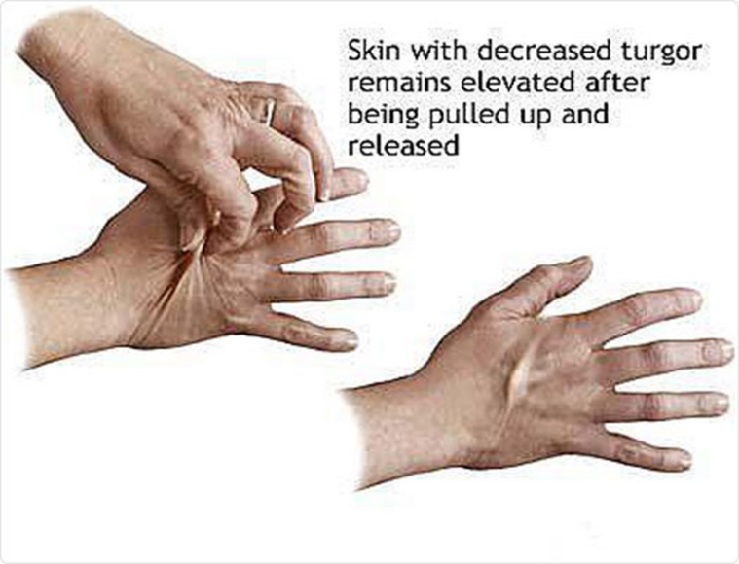
MOISTURE
The hydration of skin and mucous membranes helps to reveal body fluid imbalances
Skin moisture is determined visually and with the help of palpation.
There are the following degrees of skin moisture: normal, dry and moist.
The skin is normally smooth and dry (skin folds such as the axillae are normally moist)
Turgor is the skin's elasticity. To assess skin turgor, grasp a fold of skin on the back of the forearm with the fingertips and release.
Normally the skin lifts easily and snaps back immediately to its resting position.
Decrease of skin elasticity
The skin stays pinched or tented when turgor is poor.

Slide 27
Decrease of skin elasticity is possible:
in patients of elderly and senile age;
in case of dehydration (vomiting, diarrhea, and so on).
Increase of skin turgor (it is impossible to pull up the skinfold) often indicates a water retention, often accompanied by skin puffiness (invisible edema).

Slide 28
Studying subcutaneous fat you should pay attention to:
the degree of subcutaneous fat development,
the place of primary fat storage
edema
subcutaneous blood vessels changes.
While evaluating the degree of subcutaneous fat you should consider:
Inspection data
Palpation data
Body weight
Assessment of the subcutaneous fat by palpation
skin fold on the abdomen near the navel (the norm is 1-2 cm);
skin fold under the collarbone, and shoulder blade (the norm is 1-2 cm);

Slide 29
The degree of subcutaneous fat development may be:
normal,
high,
excessive (obesity),
decreased (underweight )
undernutrition (cachexia).
Extreme weight loss is cachexia. It is observed in case of long-term, severe intoxication, chronic infections, malignant tumors, thyroid gland and pancreas dysfunctions, some mental diseases and so on

Slide 30
Еdema is an excessive water retention in body tissues and serous cavities.
There are Local and General edema
Local edema appear most often due to:
- local dysfunction of venous or lymphoid outflow (varicose vein disease, thrombophlebitis, elephant-leg).
Remember
Edema appeared because of venous outflow dysfunction are usually accompanied by severe skin cyanosis
In other cases, most often skin is pale
General (Subcutaneous) edema appear in case of heart, kidneys diseases or diseases of other internal organs and they are caused by the mechanisms dysfunction involved in water-electrolyte balance regulation.

Slide 31
More often there are edema of heart and kidney origin
Renal edema are localized on the face, especially in the area of eyelids.
Face edema is more pronounced in the morning.
Heart edema develop gradually, and are often accompanied by shortness of breath.
The first edema in patients with heart diseases appear on the feet. Edema appear in the evening, especially after long-time walking and disappear after a night's rest.

Slide 32
In advanced cases of heart and kidney failure fluid (transudate) may accumulate in serous cavities.
It is cavity edema.
The fluid that accumulates in the serous cavities is called transudate.
Type cavity edema:
Hydrothorax
Hydropericardium
Ascites
Hydrothorax - accumulation of fluid in the pleural cavity.
Hydropericardium - accumulation of fluid in the pericardial cavity.
Ascites - accumulation of fluid in the abdominal cavity.
Anasarca - a generalized infiltration of edema fluid into subcutaneous connective tissue

Slide 33
Methods of peripheral edema determination Palpation method
1)Press the skin and subcutaneous fat of ankles, shins, sacrum or sternum with a thumb. In case of edema there will be pits remained;
2) observation of body weight dynamics
3) measuring amount of fluid you drink and amount of urine (diuresis)

